Slide 1
Eclipse IDE and Debugging
Tutorial 5: Solutions
Ravikishore Kommajosyula
Ravikishore Kommajosyula

Slide 2
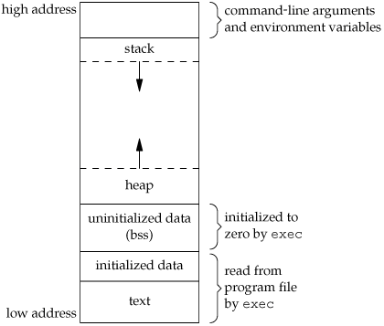
Memory Layout
Source: http://www.geeksforgeeks.org/memory-layout-of-c-program/

Slide 3
Type casting in C++
Static typecast:
Implicit conversion between types, casting through inheritance hierarchies
No runtime check on type
Dynamic typecast:
Used for handling polymorphism
Cast a pointer or reference to a polymorphic type
Re-interpret typecast:
Cast one type to another (most dangerous cast)
Source: http://stackoverflow.com/questions/332030/when-should-static-cast-dynamic-cast-and-reinterpret-cast-be-used

Slide 4
Datatype size_t
Size_t type is a base unsigned integer type
Size is chosen to store the maximum size of a theoretically possible array of any type
Enables us to write portable code (32 vs 64 bit)
Safety of normal and address arithmetic
Performance gain by using size_t and ptrdiff_t
Source: http://www.codeproject.com/Articles/60082/About-size_t-and-ptrdiff_t

Slide 5
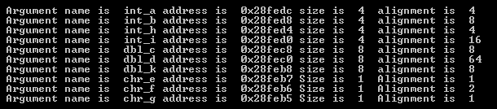
Assignment 1 in Windows
Variables declared in the right order:

Slide 6
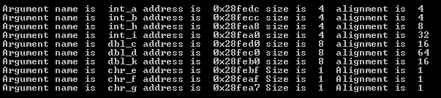
Assignment 1 in Windows
Variables declared in the right order:
Variables declaration order Jumbled:

Slide 7

Assignment 2 in Windows
Output of assignment 2: (compare stack size with Ubuntu)

